Slide 1
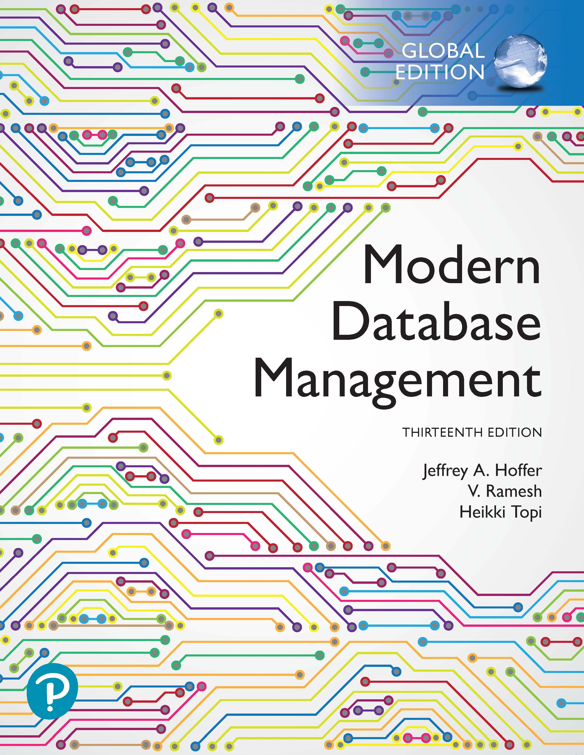
Modern Database Management
Thirteenth Edition, Global Edition
Chapter 1
The Database Environment and Development Process
Slides in this presentation contain hyperlinks. JAWS users should be able to get a list of links by using INSERT+F7
Copyright © 2020 Pearson Education Ltd. All Rights Reserved
Notes:
If this PowerPoint presentation contains mathematical equations, you may need to check that your computer has the following installed:
1) MathType Plugin
2) Math Player (free versions available)
3) NVDA Reader (free versions available)

Slide 2
Learning Objectives (1 of 2)
1.1 Define terms
1.2 Name limitations of conventional file processing
1.3 Explain advantages of databases
1.4 Identify costs and risks of databases
1.5 Distinguish between operational and informational data management
1.6 List components of database environment

Slide 3
Learning Objectives (2 of 2)
1.7 Identify categories of database applications
1.8 Explain prototyping and agile development approaches
1.9 Explain roles of individuals
1.10 Explain differences between personal, multi-tiered, and enterprise data management
1.11 Explain three-schema architectures (external, conceptual, internal)

Slide 4
Definitions
Database: organized collection of logically related data
Data: stored representations of meaningful objects and events
  Structured: numbers, text, dates
  Unstructured: images, video, documents
Information: data processed to increase knowledge in the person using the data
Metadata: data that describes the properties and context of user data
Notes:
Data by itself is not very useful. It is only after the data has been processed, summarized, and organized that it becomes useful for decision makers and knowledge workers. Processed data becomes information, which is often made available to users in the form of reports or graphical displays.
Metadata really pertains to the underlying structure of the data. When you design a database, you are specifying its metadata. When you populate the database, you are putting data into it.

Slide 5

Figure 1-1 Converting Data to Information (1 of 2)
(a) Data in context
Notes:
Here we see a report that indicates several types of data entities. We have courses and sections of these courses, and we also have the students that are enrolled in a section. Thus, we have gone from just raw data to some type of useful information by organizing the data.
The concept of an entity is something we will discuss in detail later on.

Slide 6

Figure 1-1 Converting Data to Information (2 of 2)
(b) Summarized data
Notes:
Here we see summaries of the data in graphical form. Specifically, we see a pie chart and a line graph. Rather than individual data units, the data has been processed into aggregates and categories. Sums and averages are typical forms of aggregated data, and this is another way of turning raw data into useful and actionable information.

Slide 7
Table 1-1 Example Metadata for Class Roster
Descriptions of the properties or characteristics of the data, including data types, field sizes, allowable values, and data context
Name | Type | Length | Minimum | Maximum | Description | Source
Course | Alphanumeric | 30 | Blank | Blank | Course I D and name | Academic Unit
Section | Integer | 1 | 1 | 9 | Section number | Registrar
Semester | Alphanumeric | 10 | Blank | Blank | Semester and year | Registrar
Name | Alphanumeric | 30 | Blank | Blank | Student name | Student I S
I D | Integer | 9 | Blank | Blank | Student I D (S S N) | Student I S
Major | Alphanumeric | 4 | Blank | Blank | Student major | Student I S
G P A | Decimal | 3 | 0.0 | 4.0 | Student grade point average | Academic Unit
Notes:
Metadata is not data per se. Instead it is a description of how data is to be stored and organized in a database. Metadata enables database designers and users to understand what data exist, what the data mean, and how to distinguish between data items that at first glance look similar.

Slide 8
Disadvantages of File Processing
Program-Data Dependence
  All programs maintain metadata for each file they use
Duplication of Data
  Different systems/programs have separate copies of the same data
Limited Data Sharing
  No centralized control of data
Lengthy Development Times
  Programmers must design their own file formats
Excessive Program Maintenance
  80% of information systems budget
Notes:
Prior to the advent of databases, data was stored in individual files, each being used by a separate program. This was the traditional file processing approach to data storage. As business applications became more complex, it became evident that traditional file processing systems had a number of shortcomings and limitations. Database systems were developed to overcome these shortcomings. However, there is still a lot of data that is stored in traditional file systems. Legacy systems still abound with traditional files. Even Excel spreadsheets, which are relatively modern, would fall within the same category as file systems. Many companies store their important data in a myriad of spreadsheets, and as their businesses become more complex they run up against the limitations of these storage methods.

Slide 9
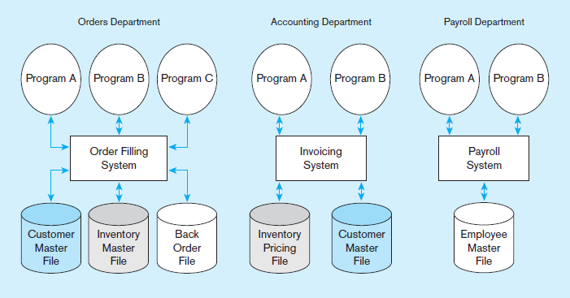
Figure 1-2 Old File Processing Systems at Pine Valley Furniture Company
Notes:
Program-data dependence: The Customer Master File is used in the Order Filling System and the Invoicing System. Suppose it is decided to change the customer address field length in the records in this file from 30 to 40 characters. The file descriptions in each program that are affected (up to five programs) would have to be modified. It is often difficult to even locate all programs affected by such changes.
Duplication of data: Note two different files containing inventory data. One is used for order filling and the other for invoicing. This duplication is wasteful because it requires additional storage space and increased effort to keep all files up to date. Data formats may be inconsistent, data values may not agree, or both. Reliable metadata is very difficult to establish in file processing systems.
The Pine Valley Furniture (PVF) company will be an ongoing case in this textbook. You will become very familiar with PVF over time.

Slide 10



The Database Approach (1 of 2)
Data models
  Graphical diagram capturing nature and relationship of data
  Enterprise Data Model – high-level entities and relationships for the organization
  Project Data Model – more detailed view, matching data structure in database or data warehouse
Entities
  Noun form describing a person, place, object, event, or concept
  Composed of attributes
Relationships
  Between entities
  Usually one-to-many
  or many-to-many
  but can also be
  one-to-one
Notes:
Chapters 2 and 3 focus on data modeling. Specifically, we’ll see and learn how to create entity-relationship (E-R) diagrams for various types of entities, attributes, and relationships. E-R diagrams help analysts to conceptualize and represent the real-world environment, which then helps guide the database design process.

Slide 11
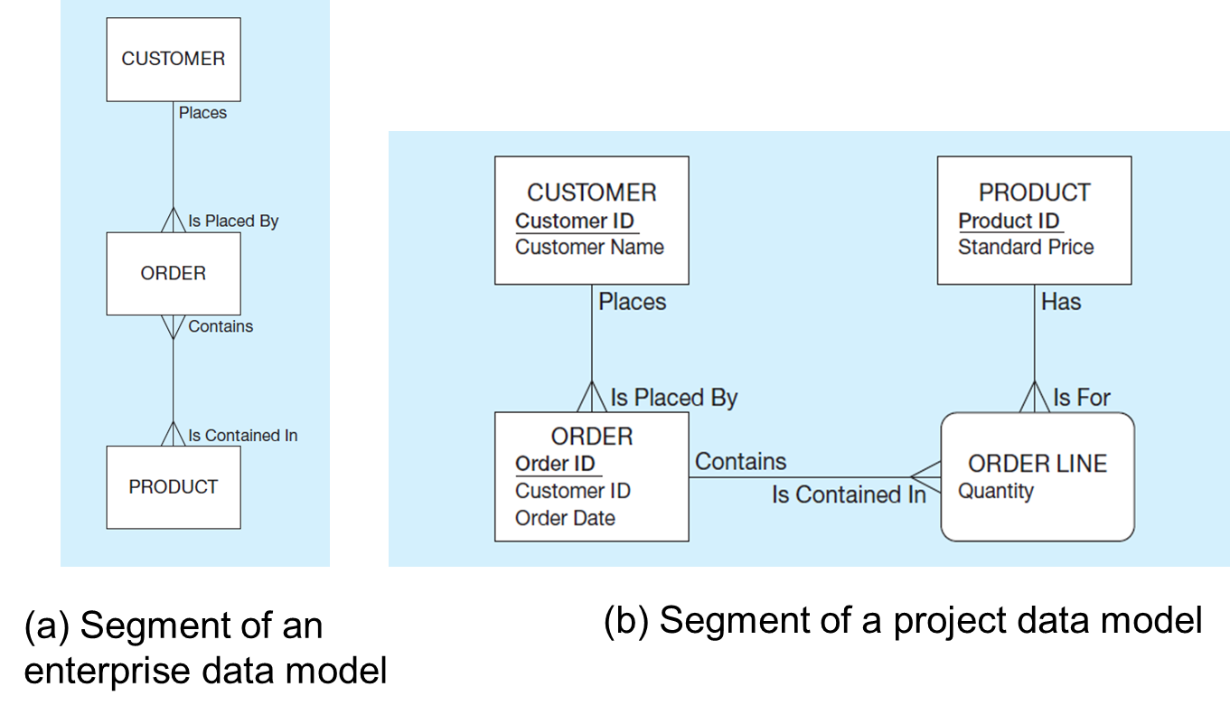
Figure 1-3 Comparison of Enterprise- and Project-Level Data Models
(a) Segment of an enterprise data model
(b) Segment of a project data model
Notes:
Here we see the distinction between an enterprise-level data model and a project data model. The enterprise-level model is more of a bird’s eye view, and less detailed than a project-level model.
Entities are represented by boxes. Relationships are represented by lines between the boxes. Attributes, which describe the important characteristics of an entity, are represented by the verbiage within the boxes.
In the enterprise model, the relationship between customers and orders is one-to-many. This means a customer may place many orders, but an order can only be placed by one customer. The crows feet of the relationship line indicates the many side of the relationship. We also see a many-to-many relationship between orders and products. One order may contain many products, and of course, a product could be contained in many orders.
The project-level model goes into more detail, including attributes, unique identifiers, and additional information about the order line.

Slide 12
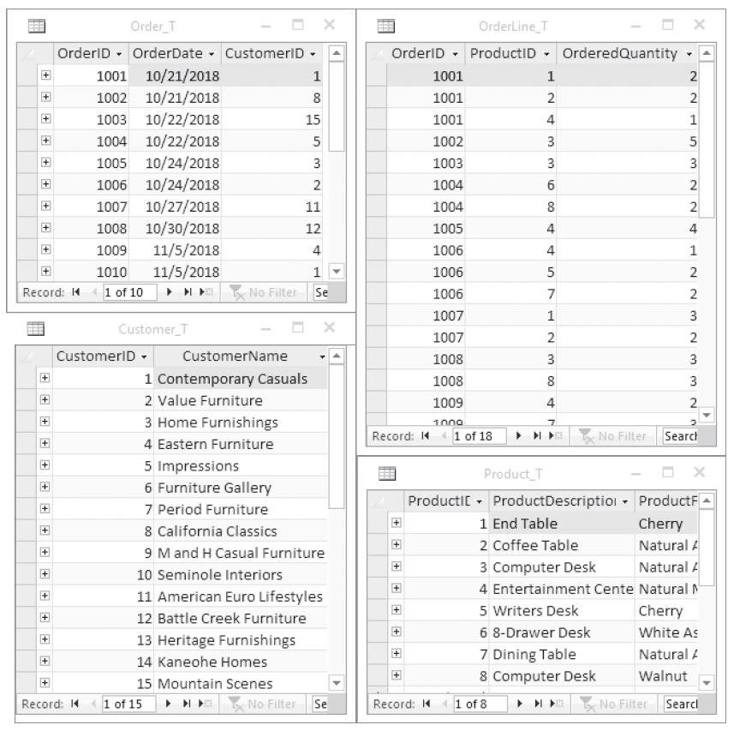
The Database Approach (2 of 2)
Relational Databases
Database technology involving tables (relations) representing entities and primary/foreign keys representing relationships (see Figure 1-17)
Notes:
The database management system (DBMS) is a software system that is used to create, maintain, and provide controlled access to user databases.
Most current DBMSs are in the form of relational databases, which represent data as a collection of tables in which all data relationships are represented by common values in related tables. We will explore relational databases in detail throughout this course.
Note that because all the data is shared in a central database, there is no longer the need for separate systems and programs to maintain their own copy of the data. This reduces duplication and increases integrity.

Slide 13
Advantages of the Database Approach
Program-data independence
Planned data redundancy
Improved data consistency
Improved data sharing
Increased application development productivity
Enforcement of standards
Improved data quality
Improved data accessibility and responsiveness
Reduced program maintenance
Improved decision support
Notes:
There are many advantages of databases over traditional files.

Slide 14
Costs and Risks of the Database Approach
New, specialized personnel
Installation and management cost and complexity
Conversion costs
Need for explicit backup and recovery
Organizational conflict
Notes:
But there are also costs and risks. It is not an easy thing to convert from traditional file processing systems to databases. Although the end result is usually beneficial to the organization, the costs of converting are significant, especially for a large company.

Slide 15
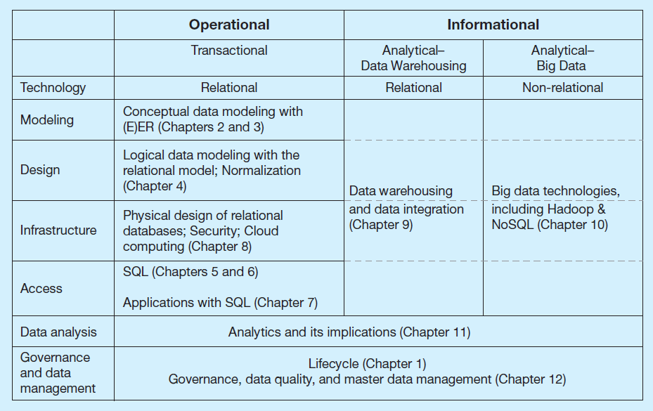
Figure 1-5 Integrated Data Management Framework
Notes:
The integrated data management framework includes both operational and informational data.
Operational databases record transactions and keep the company running. Every customer order, every sale, every purchase, every product manufactured, every employee payment, etc., is recorded. Data in operational databases is constantly changing, with insertions, deletions, and updates taking place thousands or even millions of times per day. Operational databases are usually relational databases, and this is what the book mostly focuses on.
By contrast, informational systems are used to help analysts, knowledge workers, and managers understand what’s going on and make better decisions. Some are relational and some are not. Although the book focuses more on operational database management, there is also some discussion of informational.

Slide 16
Components of the Database Environment
Data modeling and design tools – automated tools used to design databases and application programs
Repository – centralized storehouse of metadata
Database Management System (D B M S) – software for managing the database
Database – storehouse of the data
Application Programs – software using the data
User Interface – text, graphical displays, menus, etc. for user
Data/Database Administrators – personnel responsible for maintaining the database
System Developers – personnel responsible for designing databases and software
End Users – people who use the applications and databases

Slide 17
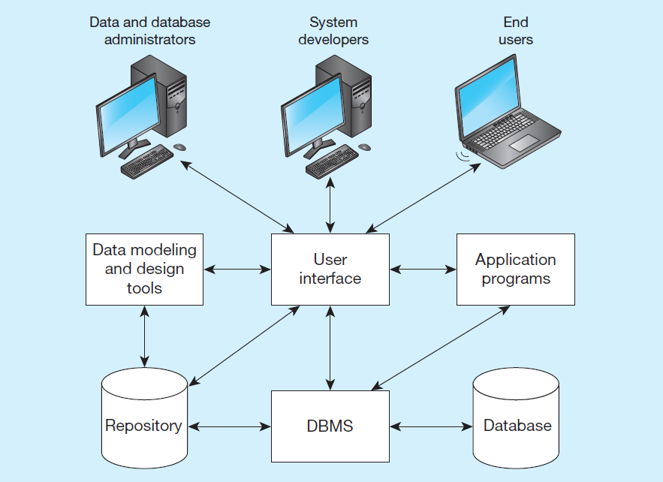
Figure 1-6 Components of the Database Environment
Notes:
Data modeling and design tools are automated tools used to design databases and application programs. These tools help with creation of data models and in some cases can also help automatically generate the “code” needed to create the database.
A repository is a centralized knowledge base for all data definitions, data relationships, screen and report formats, and other system components. In other words, the metadata resides in the repository.
DBMS is a software system that is used to create, maintain, and provide controlled access to databases. A database is an organized collection of logically related data, usually designed to meet the information needs of multiple users in an organization. A database is not the same as a repository. The database contains data, whereas the repository contains metadata. In other words, the repository defines the structure of the data.
Application programs interact with the database to provide functionality of use for the company. Relating this to figure 1-2, the application programs fulfill the order processing, invoicing, and payroll functions.
The user interface includes languages, menus, and other facilities by which users interact with various system components. Most application programs will involve user interfaces, because they will be directly used by people (users). However, not all applications involve user interfaces; some are run as batch programs in the background. For example, a program that prints paychecks may not include a user interface.
Different types of users include data and database administrators, system developers, and end users. The data administrators manage the data and database. The developers create the application programs. The end users are people who use the systems for various business functions. These can include accountants, sales people, managers, etc. Database administrators and system developers are IT people, and their principal clientele are end users.

Slide 18
The Database Development Process
S D L C
  System Development Life Cycle
  Detailed, well-planned development process
  Time-consuming, but comprehensive
  Long development cycle
Prototyping
  Rapid application development (R A D)
  Cursory attempt at conceptual data modeling
  Define database during development of initial prototype
  Repeat implementation and maintenance activities with new prototype versions
Notes:
The traditional SDLC came from the days before advanced technologies made rapid application development possible. Prototyping and its variants (such as agile, scrum, and extreme programming) came about much later in the history of information technology. Many projects combine various elements from SDLC and prototyping. In the next set of slides we’ll look at the steps in each approach.

Slide 19
Systems Development Life Cycle (S D L C)
The traditional methodology used to develop, maintain, and replace information systems
Five main steps:
  Planning – preliminary understanding of business situation. Enterprise model and conceptual data modeling.
  Analysis – thorough analysis of business situation, leading to functional requirements. Detailed conceptual data modeling.
  Design – logical and physical database design, to develop technology and organization.
  Implementation – writing programs, building databases, testing, installing, training, and documenting.
  Maintenance – monitoring, repairing, and enhancing.
Notes:
The SDLC is sometimes called a “waterfall” approach. The outputs from one phase flow down to the next. But as you can see it is also a cycle. At any stage in the process, it is possible and sometimes necessary to return to a prior stage.
This is called a cycle because it is iterative in nature. At any step, you may need to go back to a previous step.

Slide 20
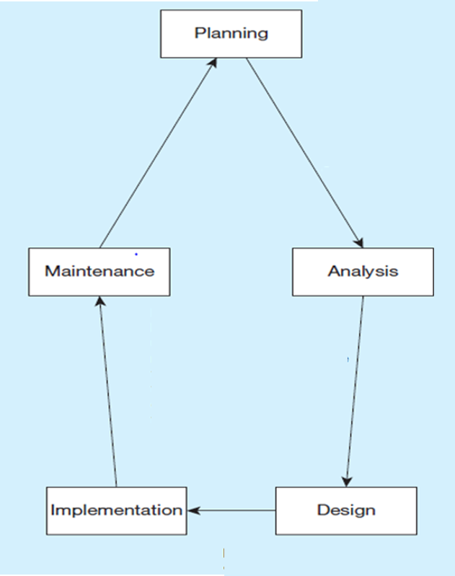
From Figure 1-8 Database Development Activities During the S D L C
Notes:
The first step is planning, which involves enterprise modeling. In early conceptual data modeling, this is high level planning, most likely creating enterprise-level models, not project-level.
After planning comes a more in-depth study called analysis. The data models developed here are more detailed (project-level), including more entities, attributes, and relationships than the enterprise models. Analysis includes detailed study, interviews, requirements elicitation, and document review, as well as studying the current system. The output from this involves a detailed set of specifications for what the desired system should do.
Whereas analysis involves identifying what the system should do, the logical design is concerned with specifying how the system is going to do it. From a database perspective, analysis involves drawing the various entity-relationship data models, whereas logical design involves defining the tables, screenshots, metadata, etc., of the finalized system. After logical design comes physical design. This can include the development or acquisition of application programs. From a database perspective, we have decided on the physical database platform (e.g. Oracle, SQL Server, mySql) and written much of the SQL for creating and manipulating our data structure.
Often physical design and implementation overlap. There’s still programming and more SQL that takes place during implementation. But other activities include installing the finished product on the production environment (previously it was only in test), and also preparing users through documentation and training. At the end of implementation is when the system is actually “up and running”.
After implementation comes maintenance. This is typically by far the longest phase, because maintenance lasts throughout the life time of the operational system. During this time there will be needs for enhancements, bug fixes, and problem-solving of various sorts. Sometimes you can think of enhancements as mini-SDLCs that produce the needed improvements to the system.
Over the course of a system’s life, maintenance may involve many miniature SDLCs for enhancements, features, or versions.

Slide 21
Alternative Information Systems Development Approaches
Traditional S D L C: methodical, structured, and time consuming
Rapid Application Development (R A D): faster and more adaptive, especially when a database is already in place
Several flavors:
  Prototyping
  Agile methodologies
  eXtreme programming
  Scrum
  D S D M (dynamic system development methodologies)
Notes:
Agile software development emphasizes “individuals and interactions over processes and tools, working software over comprehensive documentation, customer collaboration over contract negotiation, and response to change over following a plan.”

Slide 22
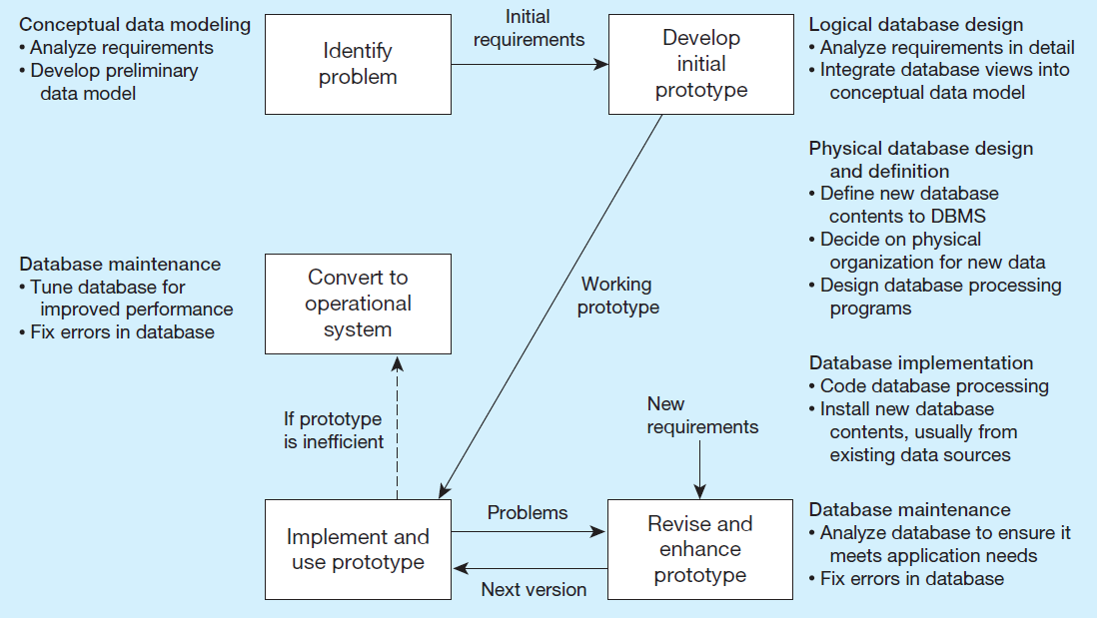
Figure 1-9 The Prototyping Methodology and Database Development Process
Notes:
Prototyping takes a different approach to system development than traditional SDLC. It is less formal and more ad hoc, involving iterations of coding and using and evolving. The concept of prototyping has evolved into several rapid application development variations.
Unlike the traditional SDLC, there is less of an emphasis on up-front planning and analysis and more of an experimentation flavor to the development process.
Prototyping involves problem identification resulting in initial requirements. Then a prototype is build. This prototype is used and refined iteratively for a period of time. If the prototype works well it becomes the de facto operational system. If the prototype doesn’t work efficiently, it is converted to a more efficient operational system.

Slide 23
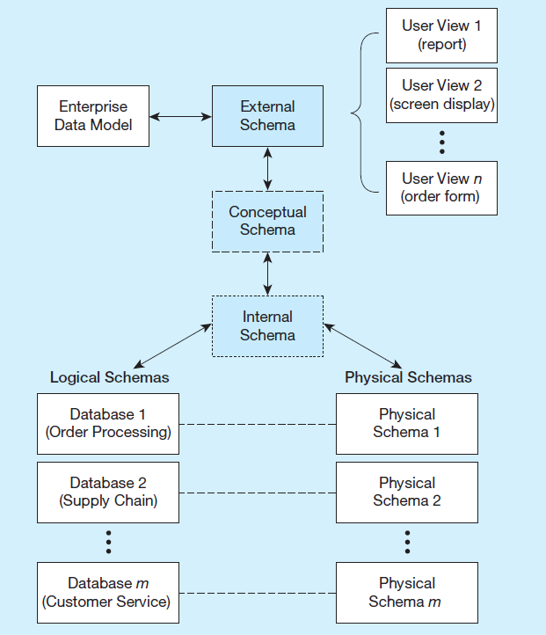
Figure 1-10 Three-Schema Architecture
Different people have different views of the database
External Schema
  User Views
  Subsets of Conceptual Schema
  Can be determined from business-function/data entity matrices
  D B A determines schema for different users
Conceptual Schema (E R models)
Internal Schema (logical and physical structures)
Notes:
The term “schema” here refers to the view you have of the system being developed. Users of a system have one view, based on the reports, forms, and interactions they have with the system. Designers have a view of the entities, attributes, and relationships involved in the world being modeled (the conceptual schema), as well as a view of tables, fields, and primary and foreign keys, together with an understanding of what makes a database well structured and efficient (the internal schema).
If you are a database designer, you will be extensively involved in the logical and physical pieces of the internal conceptual schema. You will be particularly involved in the physical schema if you are a database administrator (DBA). If you are a user, these schemas don’t matter much to you; rather you will be involved in the external schema.

Slide 24
Managing People Involved in Database Development
Project – a planned undertaking of related activities to reach an objective that has a beginning and an end
Initiated and planned in planning stage of S D L C
Executed during analysis, design, and implementation
Closed at the end of implementation
Notes:
Project management is an important skill in any information systems project, and managing the database design and implementation tasks is part of project management.
Projects often are organized into tasks and subtasks, each of which is scheduled for an expected time period, and assigned to various people involved in the project. It is up to the project manager to monitor the progress and cost of the project.

Slide 25
Database Project Team Members (1 of 2)
Business analysts – analyze business situation and establish requirements
Systems analysts – like business analysts, but also have technical expertise for overall information systems
Database analysts and data modelers – analysts who focus on database
Users – the “customers” communicate their needs to analysts
Programmers – coders of the programs that interact with the database
Notes:
There are many different people, each with different perspectives, skills, and needs, involved in a systems development project.

Slide 26
Database Project Team Members (2 of 2)
Database architects – establish standards for data in business units
Data administrators – responsible for existing databases, ensuring data integrity and consistency
Project managers – oversee the projects, manage the personnel
Other technical experts – network, operating system, documentation, etc.
Notes:
There are many different people, each with different perspectives, skills, and needs, involved in a systems development project.

Slide 27
Evolution of Database Systems
Driven by four main objectives:
  Need for program-data independence in order to reduce maintenance
  Desire to manage more complex data types and structures
  Ease of data access for less technical personnel
  Need for more powerful decision support platforms
Notes:
Here are some of the motivations that led to the evolution of database systems.

Slide 28
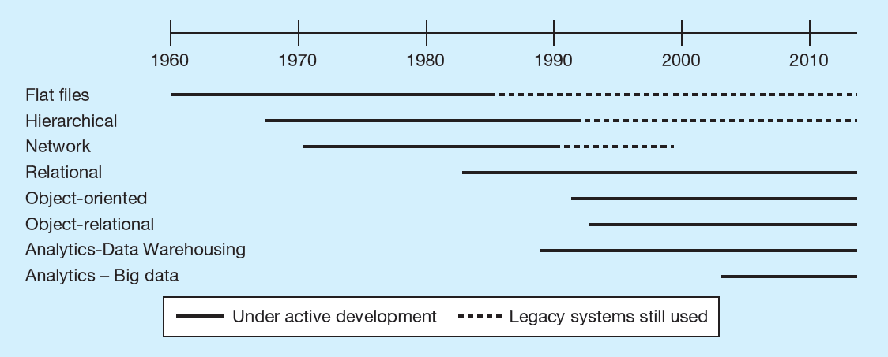
Figure 1-11 The Range of Database Technologies: Past and Present (1 of 4)
(a) Evolution of database technologies
Notes:
Over the years since the advent of computer data processing systems in business, there have been many approaches to database technology. We already discussed flat files and their problems. Early attempts to solve these problems led to hierarchical and network databases. Legacy systems, those initially created in the 1950s and 1960s, sometimes still use these earlier technologies.
The relational database is the most common form, especially for business applications. However, others also exist, including object-oriented and object-relational. Data warehousing is commonly used for managerial decision making.

Slide 29
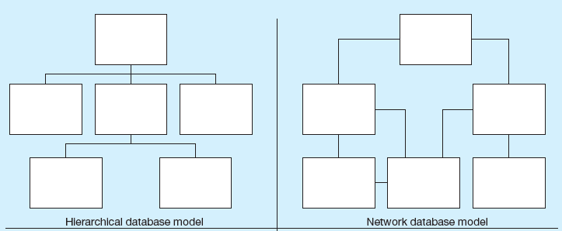
Figure 1-11 The Range of Database Technologies: Past and Present (2 of 4)
(b) Database architectures
Notes:
The hierarchical and network database models were the earliest attempts to structure data according to relationships between entities. But they fell short because they were very inflexible. For example, many-to-many relationships are impossible in hierarchical databases; and although they are possible in network models, the are difficult to modify in these structures.

Slide 30
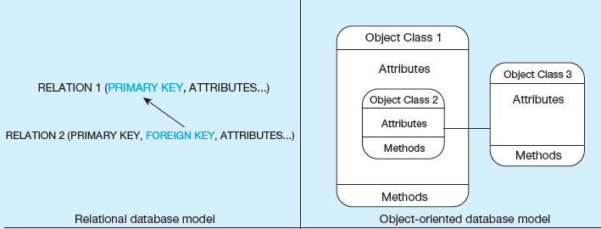
Figure 1-11 The Range of Database Technologies: Past and Present (3 of 4)
(b) Database architectures
Notes:
The relational model is the most ubiquitous, and represents relationships as primary-to-foreign key associations in different “relations”. Here we see some confusing terminology. There is the concept of “relationship”, which was shown as lines between boxes in figure 1-3. And there is another concept of “relation”, which is really like a database table. We’ll see this distinction later in the semester.
Object-oriented databases are interesting in that they allow for a sort of inheritance between classes and subclasses. Also, unlike relations (tables) in relational databases, objects in object-oriented databases are capable of behaviors (program code) in the form of “methods”. If you take a course in Java or another object-oriented language, you will become familiar with these ideas.

Slide 31
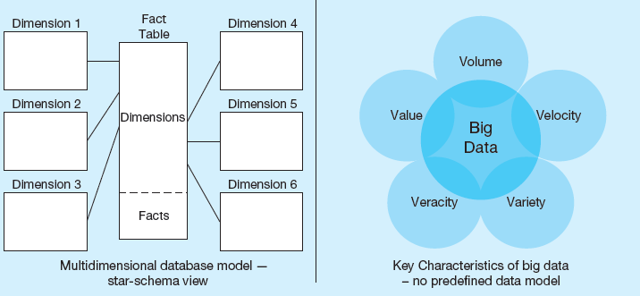
Figure 1-11 The Range of Database Technologies: Past and Present (4 of 4)
(b) Database architectures
Notes:
Multidimensional models are typically based on data warehouses, and are used for decision support purposes. The star schema is a typical data warehouse structure. It’s still a relational database, but here there are two types of tables. Fact tables contain numerical data that can be aggregated (prices, sales revenue, payments, etc.). Dimensions are different “lenses” by which you can slice and dice the numerical data (customers, departments, products, time periods, etc.). The term Online Analytical Processing (OLAP) refers to the types of systems that use multidimensional data.
Big data is an emerging concern and opportunity for business. This refers to the huge amount of often unstructured data (such as tweets, customer reviews, blogs, emails, etc.) that are increasingly important for business decision-making. The Vs (volume, velocity, variety, veracity, and value) are big buzzword in the big data world.

Slide 32
The Range of Database Applications
Personal Databases
  Typical size in the megabytes
  Intended for one user
Departmental Multi-Tiered Client/Server Databases
  Typical size in the gigabytes
  Intended for several users, usually doesn’t exceed 100, department-wide
Enterprise Applications
  Typical size in the gigabytes, terabytes, or even petabytes
  Intended for a very large user base, company wide

Slide 33
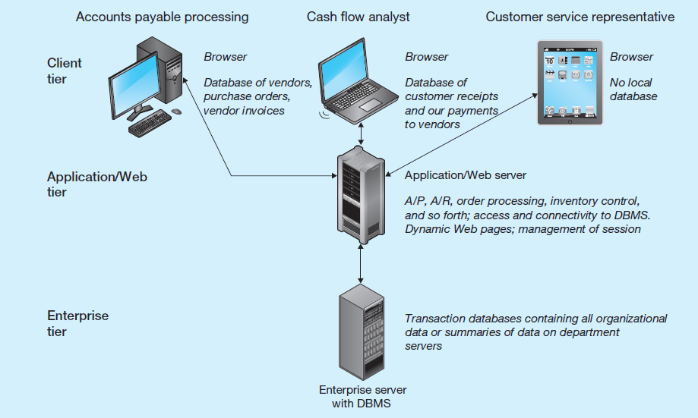
Figure 1-12 Multi-Tiered Client/Server Database Architecture
Notes:
Most Web applications follow the 3-tier approach. Databases are typically at an enterprise tier, application program code is at an application/Web tier, and user interfaces for different users are at the client tier.

Slide 34
Types of Enterprise Applications
Enterprise Systems (typically involve relational databases)
  Backbone of an organization
  Enterprise resource planning (E R P)
  Customer relationship management
  Supply chain management
  Human resource management and payroll
Data Warehouses (typically involve relational databases)
  Integrates data from multiple data sources
  Maintain historical data
  Help identify patterns and trends
Data Lakes (often don’t involve relational databases)
  Large integrated repository for internal and external data that does not follow a predefined schema

Slide 35
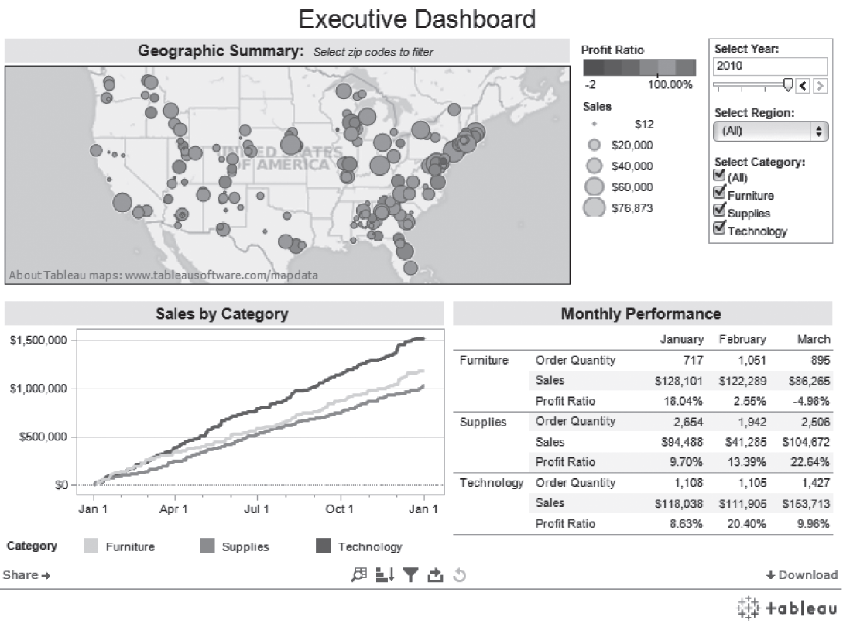
Figure 1-13 An Example of an Executive Dashboard
(http://public.tableausoftware.com/profile/mirandali#!/vizhome/Executive-Dashboard_7/ExecutiveDashboard)
Courtesy Tableau Software
Notes:
Figure 1-13 presents an example of what an output from a data warehouse might look like.

Slide 36
Pine Valley Furniture
P V F is a fictional furniture company
Will be used as a case throughout the book
Chapter 1 topics include
  Database Evolution at Pine Valley Furniture Company
  Project planning
  Analyzing database requirements
  Designing the database
  Using the database
  Administering the database
  Future of databases at P V F

Slide 37

Copyright

